Slide 1
PROBLEM STATEMENT
Title: Serverless Data Analysis Platform
Project Description: Create a serverless data analysis platform that allows Lambda functions to access and process data from both a public RDS database and a private RDS database. The platform should store results in s3 bucket.
RDS
Lambda
S3
VPC and subnets

Slide 2
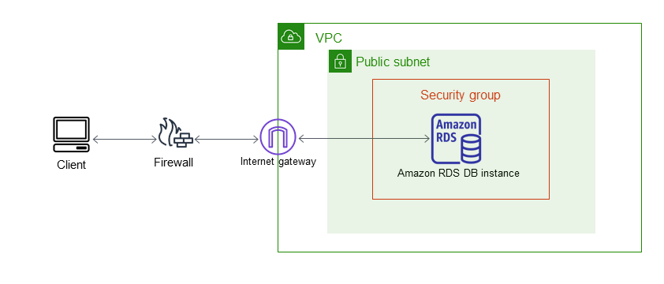
Publically Accessible RDS

Slide 3
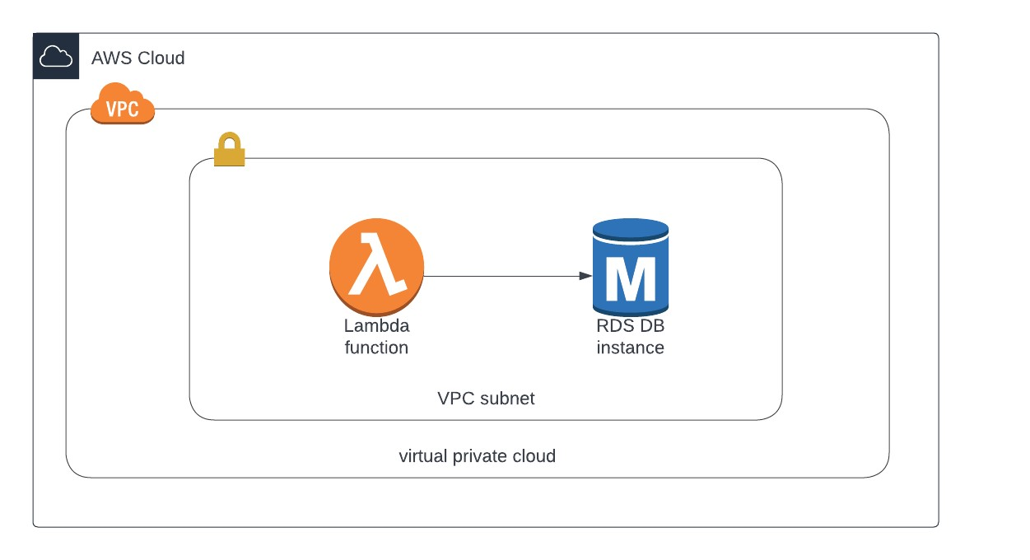
Privately Accessible RDS

Slide 4
PROBLEM STATEMENT
Title: Sales Analytics Dashboard for Global Energy Industry
Project Description: Develop a comprehensive Dashboard in Amazon QuickSight to gain insights into sales by multiple attributes.
QuickSight

Slide 5
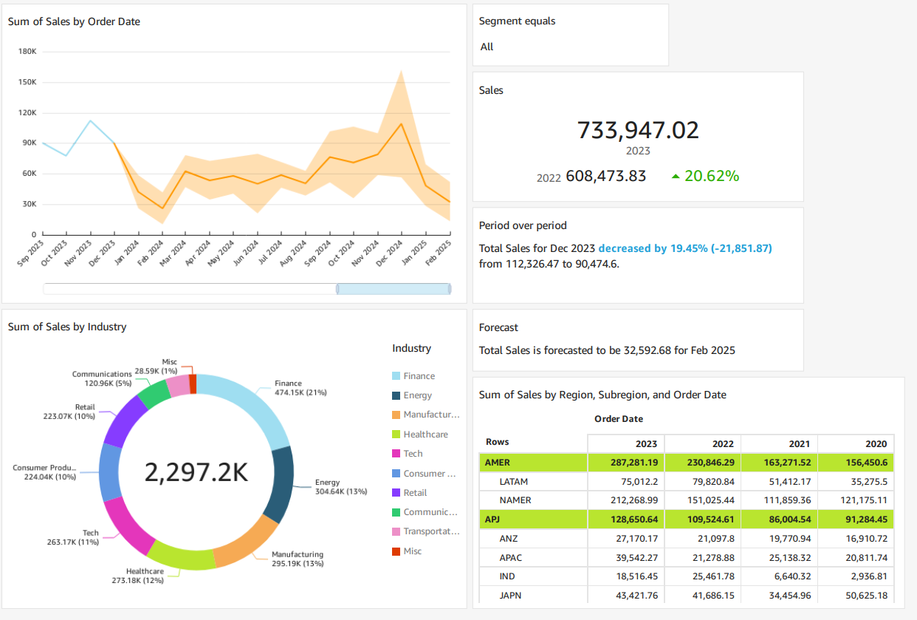
QuickSight Dashboard

Slide 6
PROBLEM STATEMENT
Title: Data Ingestion and Extraction Pipeline for Redshift
Project Description: Build a comprehensive data pipeline that facilitates the loading of data from Amazon S3 into Amazon Redshift, supports both compressed and uncompressed files, unloads encrypted data files from Redshift back to S3, and offers the flexibility to unload data in delimited or fixed-width formats as required.
S3
Redshift

Slide 7
PROBLEM STATEMENT
Title: Conditional Workflow State Machine
Project Description: Create an AWS Step Functions state machine that performs the addition of two numbers and then executes different branches of the workflow based on whether the result is even or odd. This project helps you understand how to build conditional workflows using AWS Step Functions.
a. Step Function
b. Lambda

Slide 8
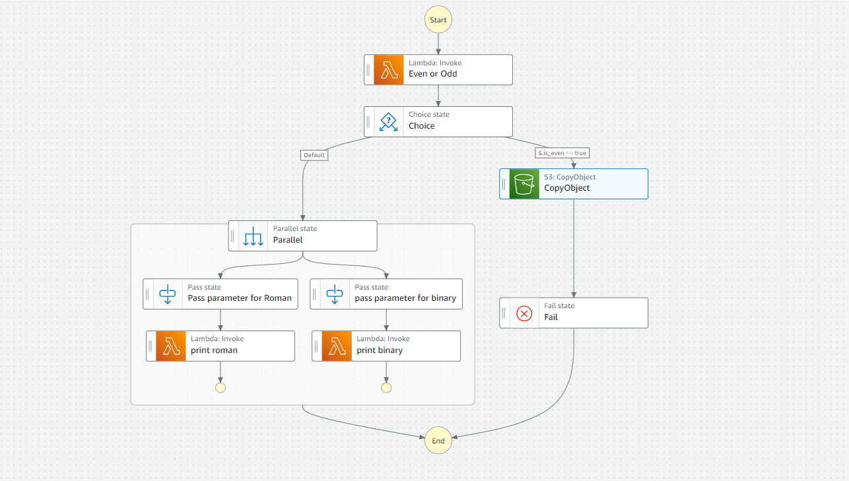
CONDITIONAL WORKFLOW

Slide 9
PROBLEM STATEMENT
Title: Real-time IoT Data Ingestion and Analysis with AWS Kinesis and IoT Core
Project Description: Create a comprehensive project that demonstrates the end-to-end process of ingesting real-time IoT data using AWS Kinesis and AWS IoT Core. This project involves setting up IoT devices, streaming data to AWS and saving data to S3
a. IOT Core
b. Kinesis Firehose
c. S3
d. Lmabda

Slide 10
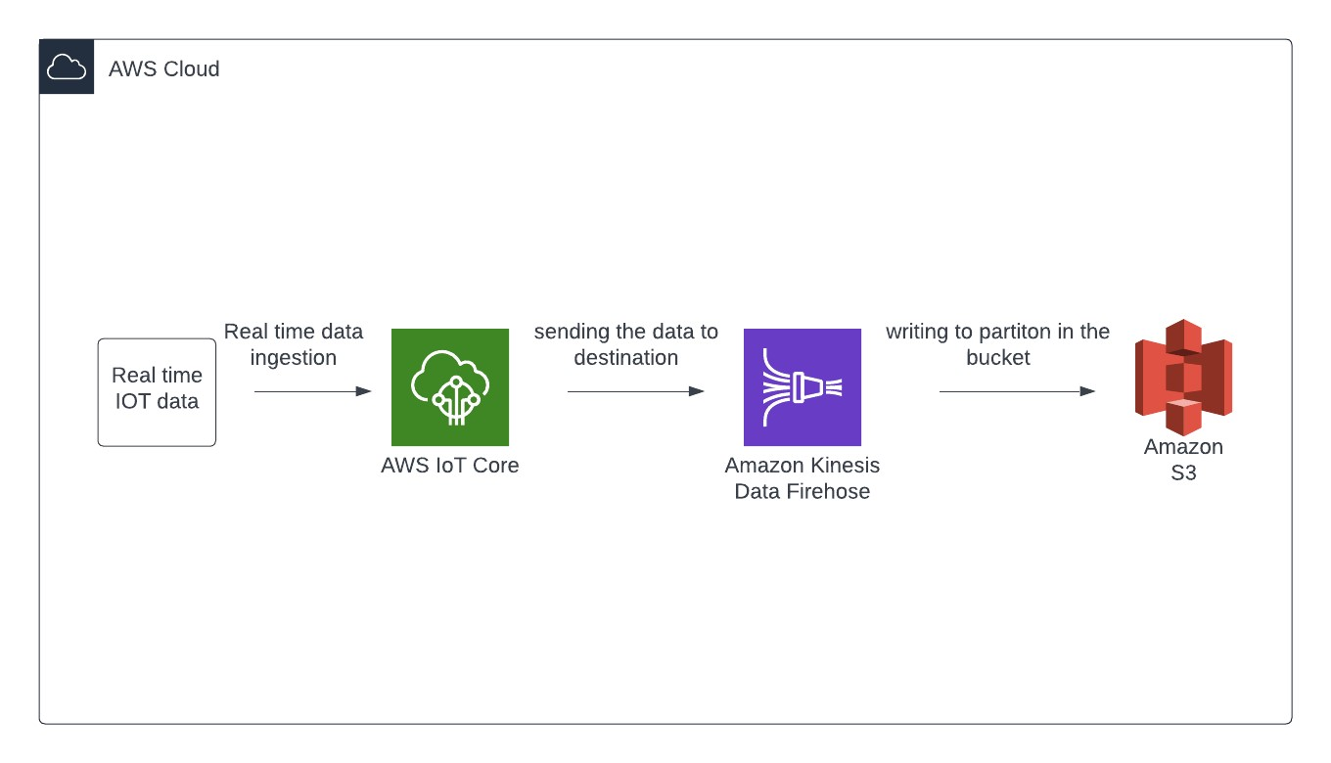
Real Time Data Ingestion

Slide 11
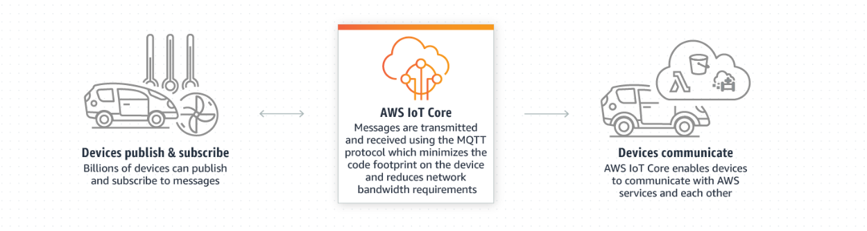
AWS IOT CORE

Slide 12
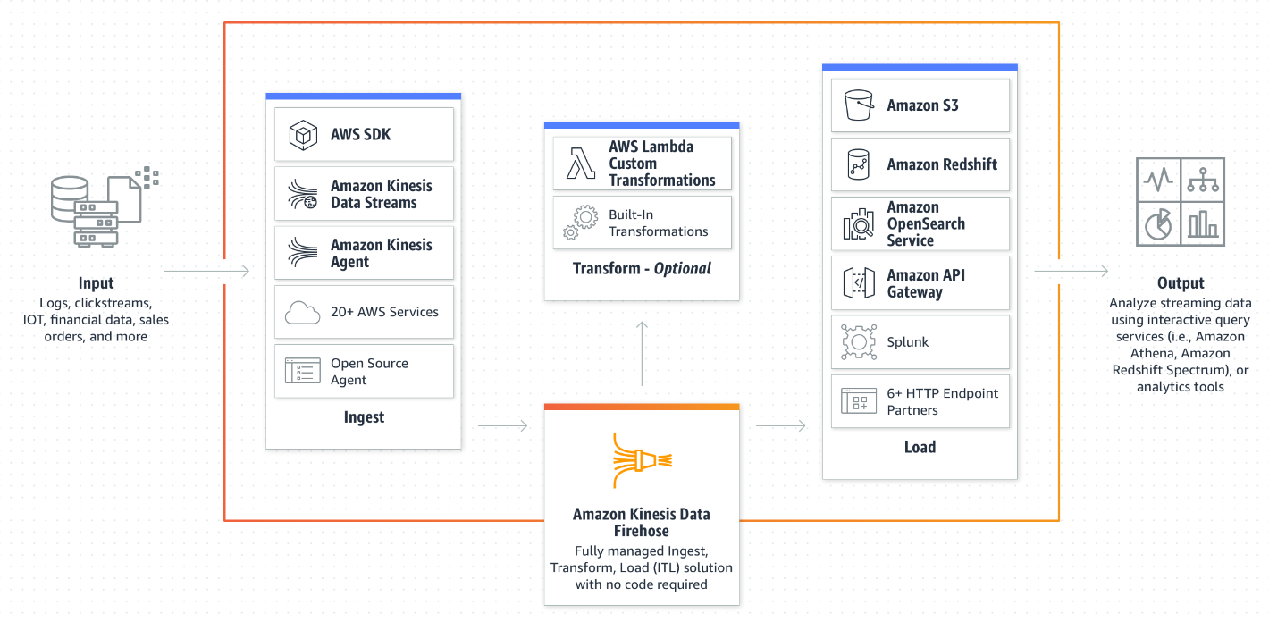
KINESIS FIREHOSE

Slide 13
PROBLEM STATEMENT
Title: Seamless On-Premises to AWS RDS Database Migration with AWS DMS
Project Description: The primary objective of this project is to execute a streamlined and secure migration of an on-premises database to an Amazon Web Services (AWS) Relational Database Service (RDS) instance utilizing the AWS Database Migration Service (DMS). This migration will ensure improved data management, scalability, and availability while maintaining data integrity and minimizing business disruptions.
RDS
DMS
EC2
SSMS

Slide 14
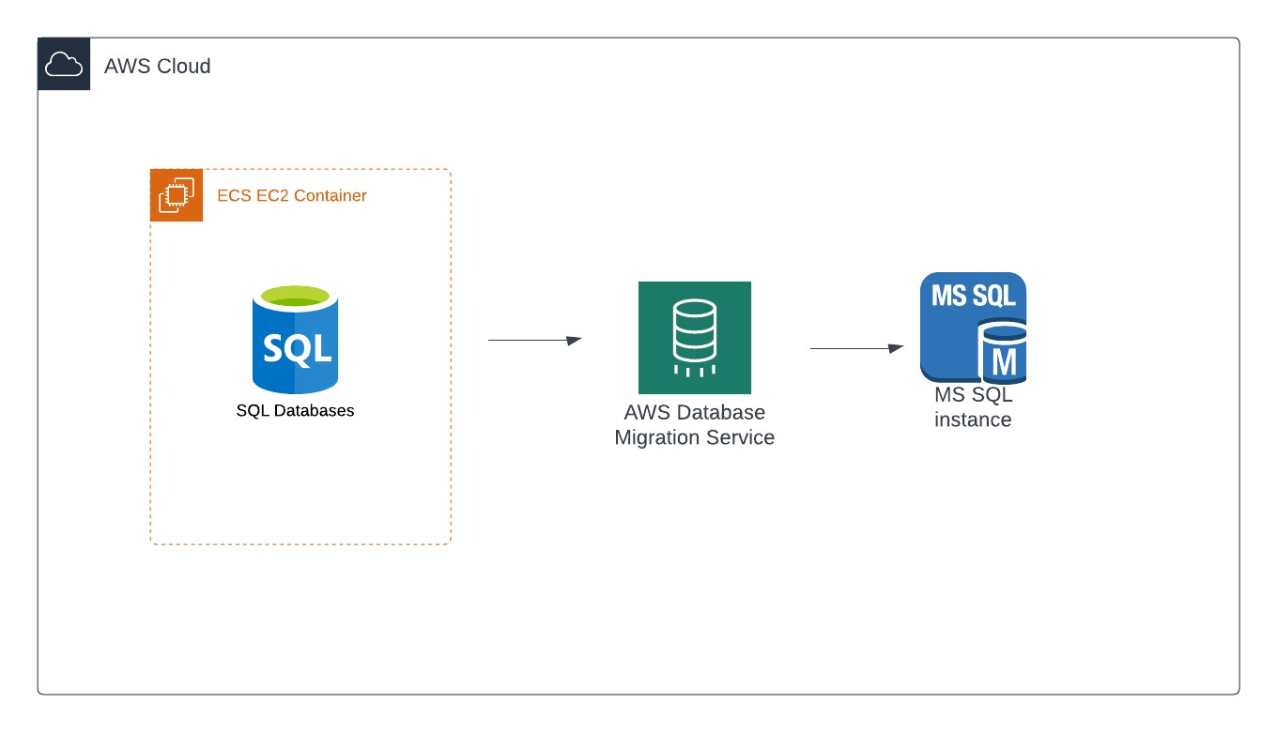
Architecture

